Slide 1
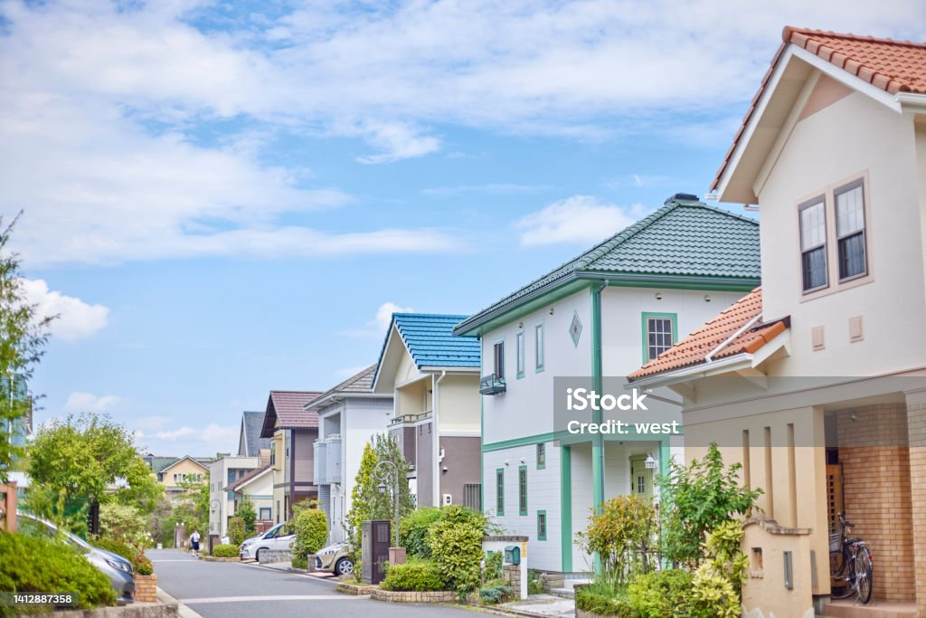
House Rental system
ISHITA TYAGI

Slide 2
UPCOMING CONTENTS
Introduction.
Review.
Objective.
Modules.
Sub Modules.
Technologies.
Software.
Conclusion.

Slide 3
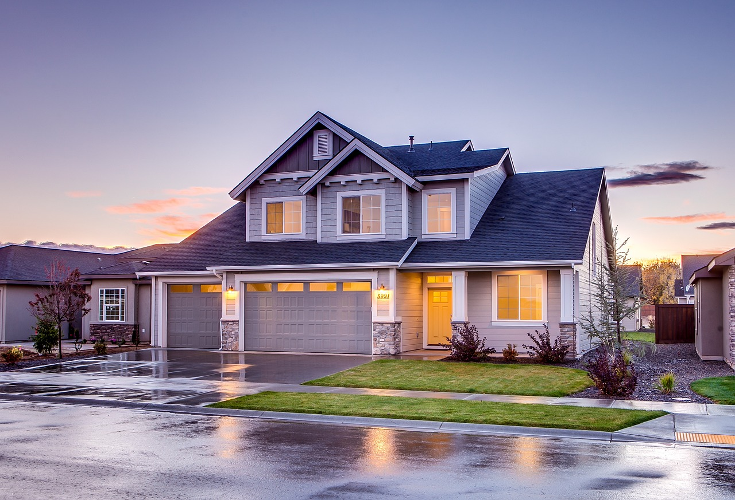
INTRODUCTION
The E House Rental System uses technology for an immersive, user-focused rental experience. Its user-friendly design, rich property details, and seamless virtual tours redefine home searching, making it efficient and enjoyable. Whether you're a property manager streamlining listings or a tenant seeking rentals, it's a real estate industry game-changer.

Slide 4

REVIEW
The emergence of E House Rental Systems has revolutionized the real estate industry by providing users with a seamless and convenient way to explore and rent properties. This review delves into the key aspects and functionalities of E House Rental Systems, highlighting their significance in modern real estate practices.

Slide 5
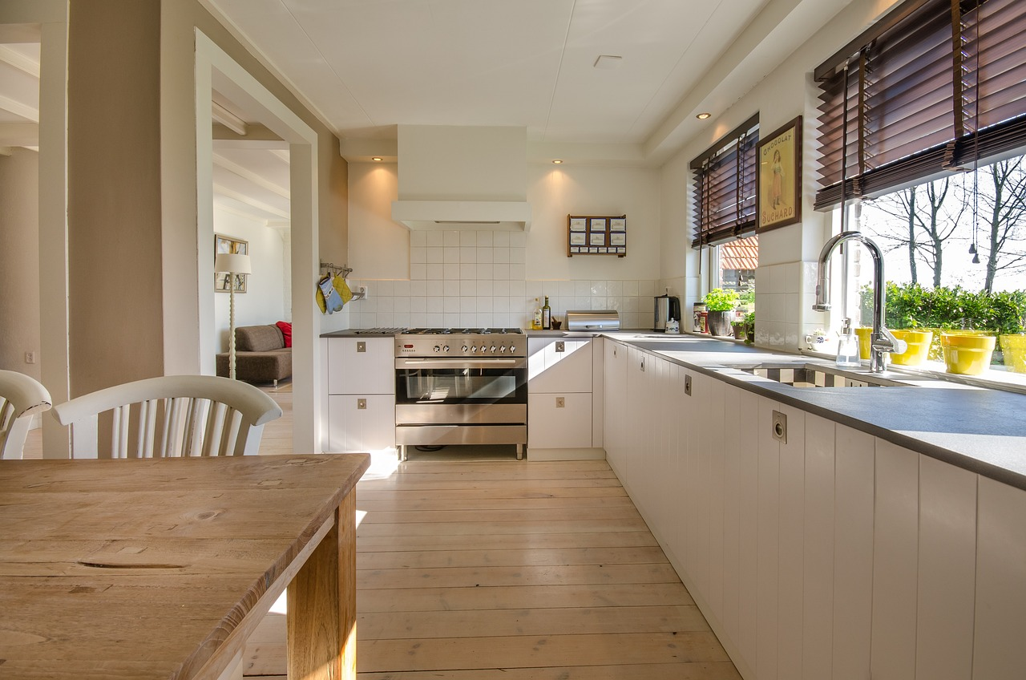

OBJECT
The E House Rental System is designed to revolutionize the house rental industry by offering users an immersive virtual house viewing experience. This system comprises two primary modules: the Admin Module and the User Module. Our goal is to provide an intuitive and responsive website that showcases comprehensive information, images, and virtual tours of available rental properties.
Virtual House Tour
Responsive Website Design
User Module
Admin Module
Visual Content

Slide 6
MODULES
USER
ADMIN

Slide 7
USER
Home Page
House page
Review
Login
Logout
About us

Slide 8
ADMIN
User Management
Content Management
Login
Dashboard
Logout

Slide 9
Technologies
HTML CSS
REACT
BOOTSTRAP
MySQL

Slide 10

Editor

Slide 11
CONCLUSION
To conclude ,
The E House Rental System has a objective of creating an efficient, user-centric, and technologically advanced platform for house rentals. It provides a virtual experience that simplifies the house-hunting process for users while offering robust administrative tools for property management.

Slide 12


